Slide 1
The Circulatory System
An Overview of How Blood Circulates in the Body
NGSS Standard: MS-LS1-3
Florida Benchmark: SC.6.L.14.5
John Mark L. Barbado, M.Ed.
STEM Educator

Slide 2
Essential Question
How does the circulatory system work to deliver oxygen and nutrients to the body?

Slide 3
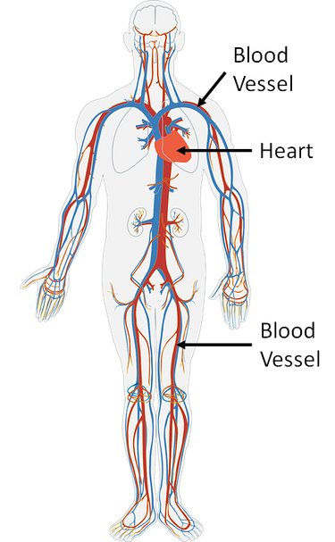
Introduction to the Circulatory System
The circulatory system is responsible for transporting oxygen, nutrients, and waste products throughout the body. It keeps organs and tissues supplied with essential substances to function properly.
375px-CirculatorySystem.png (375×607)

Slide 4
Key Components of the Circulatory System
• Heart: Pumps blood throughout the body.
• Blood Vessels: Tubes that carry blood (arteries, veins, capillaries).
• Blood: Carries oxygen, nutrients, and waste.

Slide 5
The Heart
• Function: Pumps blood through two loops: pulmonary and systemic circulation.
• Parts of the Heart: Right Atrium, Left Atrium, Right Ventricle, Left Ventricle
• Fun Fact: The heart pumps around 2,000 gallons of blood every day!

Slide 6
Types of Blood Vessels
• Arteries: Carry oxygen-rich blood away from the heart.
• Veins: Carry oxygen-poor blood back to the heart.
• Capillaries: Smallest blood vessels where exchange of oxygen, nutrients, and waste occurs.

Slide 7
Blood Components
Red Blood Cells (RBCs): Carry oxygen.
White Blood Cells (WBCs): Fight infections.
Platelets: Help blood clot.
Plasma: Carries nutrients and waste.

Slide 8
Pulmonary and Systemic Circulation
Pulmonary Circulation: Blood flows from the heart to the lungs to get oxygen and back to the heart.
Systemic Circulation: Oxygen-rich blood is pumped to the body; oxygen-poor blood returns to the heart.

Slide 9
How the Circulatory System Works
Oxygenated blood is pumped from the heart through arteries to the body.
Blood moves through capillaries where oxygen is exchanged for carbon dioxide.
Deoxygenated blood returns to the heart through veins.

Slide 10
How Circulatory and Respiratory Systems Work Together
• The circulatory system transports oxygen picked up by the lungs to body tissues.
• The circulatory system removes carbon dioxide from tissues, which is then expelled by the respiratory system when we exhale.

Slide 11
The Circulatory System in Everyday Life
• Exercise: Heart rate increases to deliver more oxygen to muscles.
• Cuts and Healing: Platelets help clot blood and prevent excessive bleeding.
• Breathing: Oxygen moves into the blood through the lungs to be delivered to cells.

Slide 12
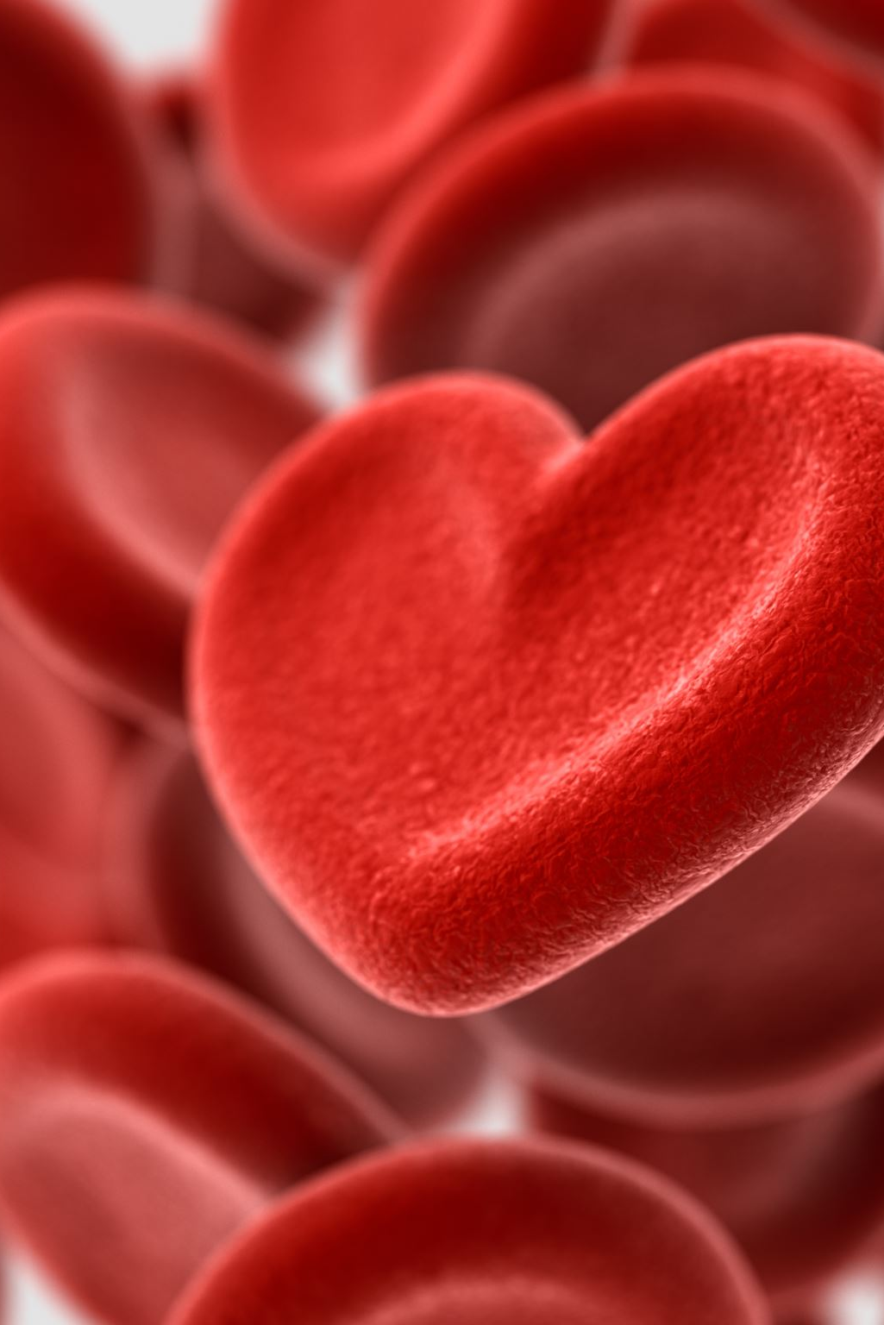
Fun Fact!
Did you know? Your heart beats about 100,000 times a day and pumps blood through 60,000 miles of blood vessels!

Slide 13
Take Care of Your Circulatory System
• Exercise regularly
• Eat a balanced diet
• Stay hydrated
• Avoid smoking

Slide 14
Comprehension Questions
1. What is the function of the heart in the circulatory system?
2. How do arteries and veins differ in their roles?
3. What happens to blood as it passes through the capillaries?
4. How does the circulatory system interact with the respiratory system?
5. Why is it important for blood to circulate continuously throughout the body?

Slide 15
Conclusion
The circulatory system is essential for life, as it ensures the transport of oxygen, nutrients, and removal of waste from the body. By understanding how the circulatory system works, we can take better care of our health!

Slide 16
References
National Institutes of Health (NIH). (n.d.). How Your Heart Works. Retrieved from https://www.nih.gov
American Heart Association. (n.d.). The Circulatory System. Retrieved from https://www.heart.org
MedlinePlus. (n.d.). Circulatory System. Retrieved from https://medlineplus.gov

