Slide 1
The Phases of the Moon
Florida Benchmark: • SC.4.E.5.2: Describe the changes in the observable shape of the Moon over the course of about a month.
Next Generation Science Standards (NGSS): • MS-ESS1-1: Develop and use a model of the Earth-Sun-Moon system to describe the cyclic patterns of lunar phases, eclipses of the Sun and Moon, and seasons.

Slide 2
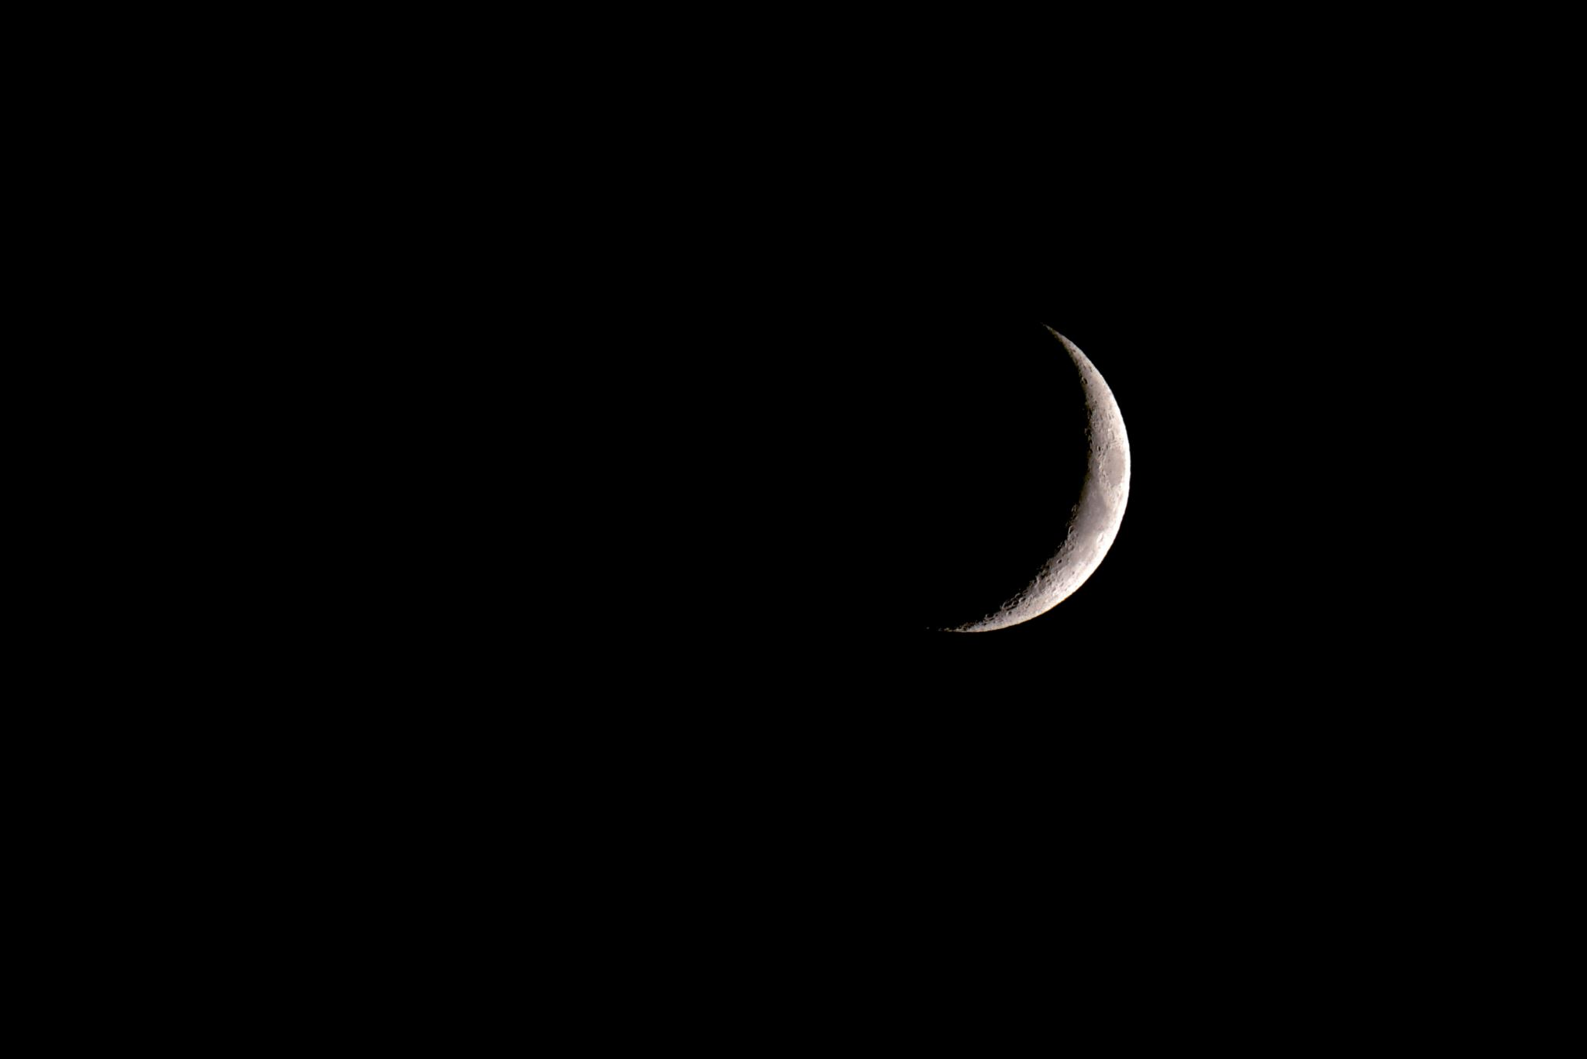
Essential Question:
Why does the Moon appear to change shape throughout the month?

Slide 3
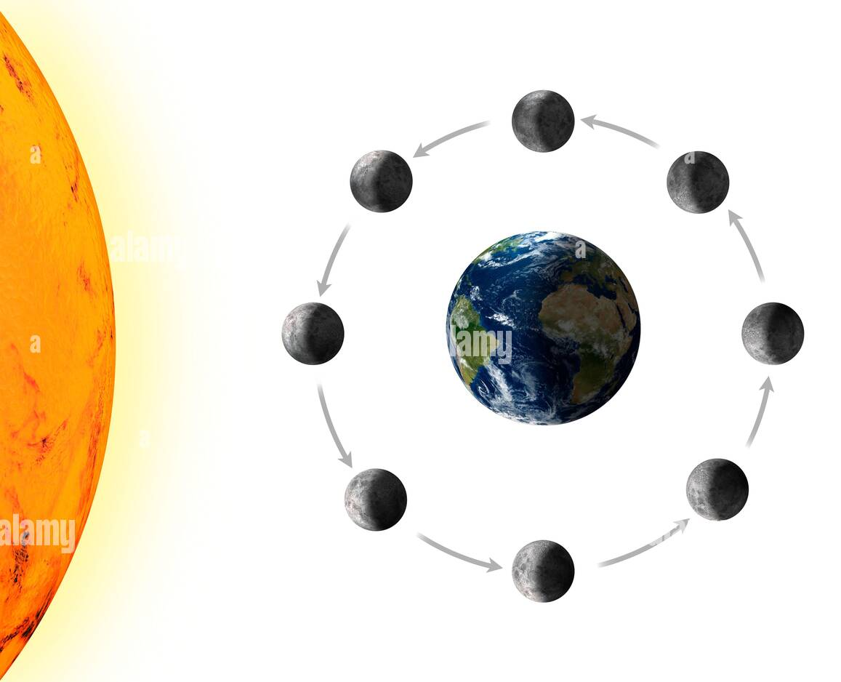
What is the Moon?
The Moon is Earth's natural satellite, meaning it orbits Earth.
It is a rocky, airless world that is 1/4th the size of Earth.
The Moon has no light of its own; it reflects sunlight.
The Moon’s gravitational pull causes tides on Earth.
phases-of-the-moon-as-seen-from-space-illustration-as-the-moon-orbits-the-earth-the-amount-of-sunlight-seen-on-its-visible-hemisphere-varies-in-a-r-2ADD3DB.jpg (1300×1042)

Slide 4
What Are Moon Phases?
The Moon doesn’t actually change shape—it only looks different from Earth because of the way sunlight reflects off it.
The different shapes we see are called Moon phases.
It takes about 29.5 days for the Moon to complete a full cycle.
phases-of-the-moon-lunar-phase-earth-and-sun-luna-the-lunar-cycle-change-night-sky-infographic-eclipse-concept-planets-in-solar-system-cartoon-illustration-vector.jpg (1920×1477)

Slide 5
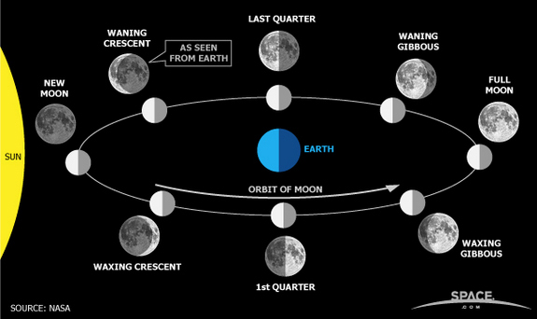
Why Do We See Different Phases?
The Moon orbits Earth, and as it moves, the sunlight hits it from different angles.
The part of the Moon that is lit up is what we see from Earth.
This creates a predictable cycle of phases.
_4350640_orig.jpg (575×342)

Slide 6
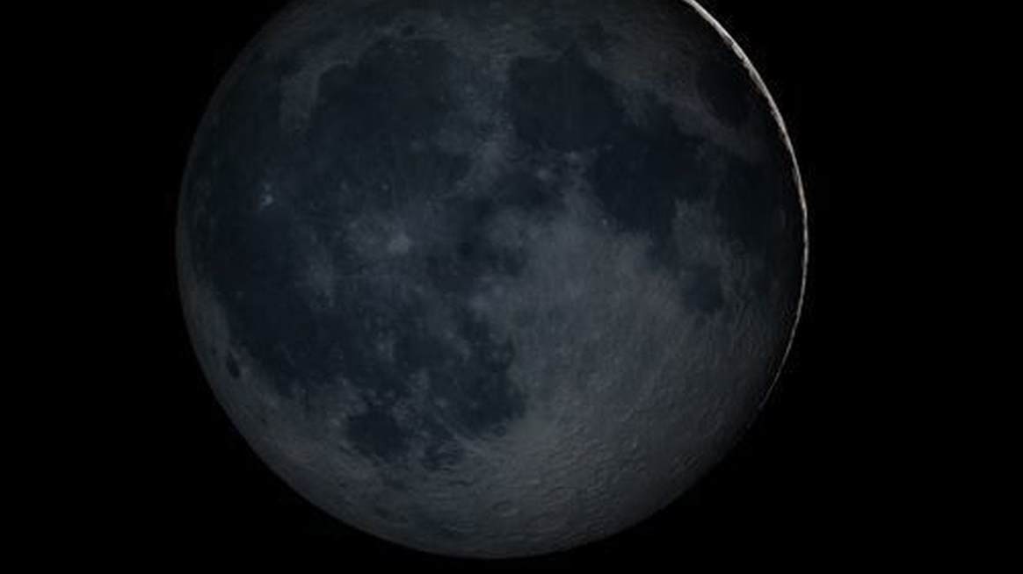
1. New Moon – The Moon is not visible.
new-moonjpg-6f1bdebaead0107e.jpg (1280×748)

Slide 7
2. Waxing Crescent – A small sliver of light appears.

Slide 8
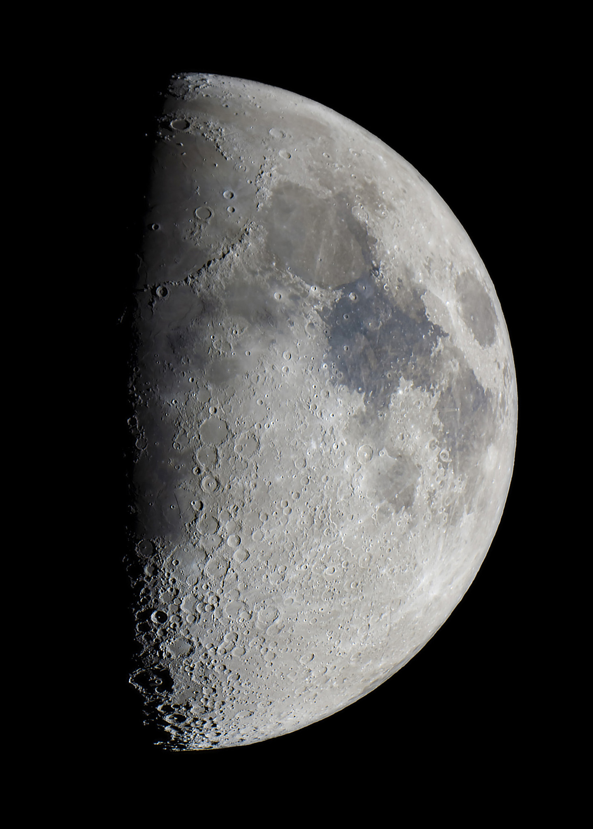
3. First Quarter – Half of the Moon is visible.
Moon2808WaxGib150922.jpg (2048×2048)
Notes:
^{Rome://settings/searchEngines}
^{default-search}
^{Rome://settings/searchEngines}
^{Shop}
08462-3203-4d6e-b7e5-0db28a4e4b8b

Slide 9
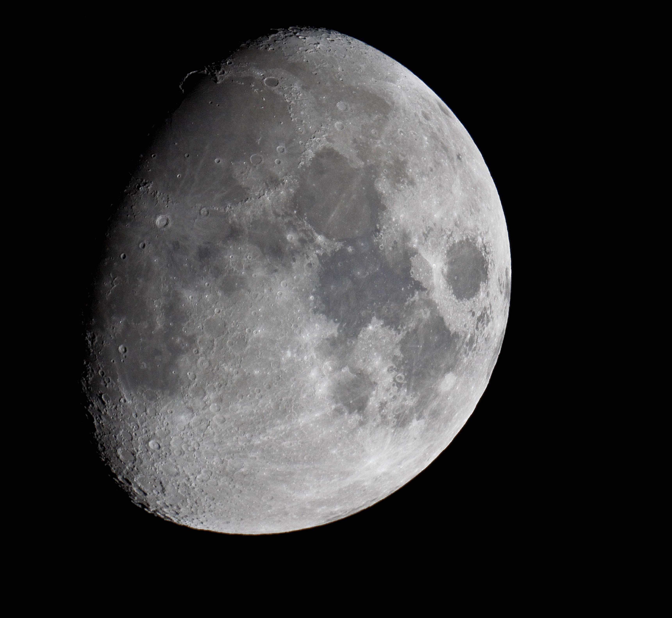
4. Waxing Gibbous – Almost a full Moon. Is an intermediate phase of the Moon that starts right after the First Quarter and lasts until it becomes a full Moon. It is more than half illuminated but less than fully illuminated
ap595_7102011 (4752×3168)

Slide 10
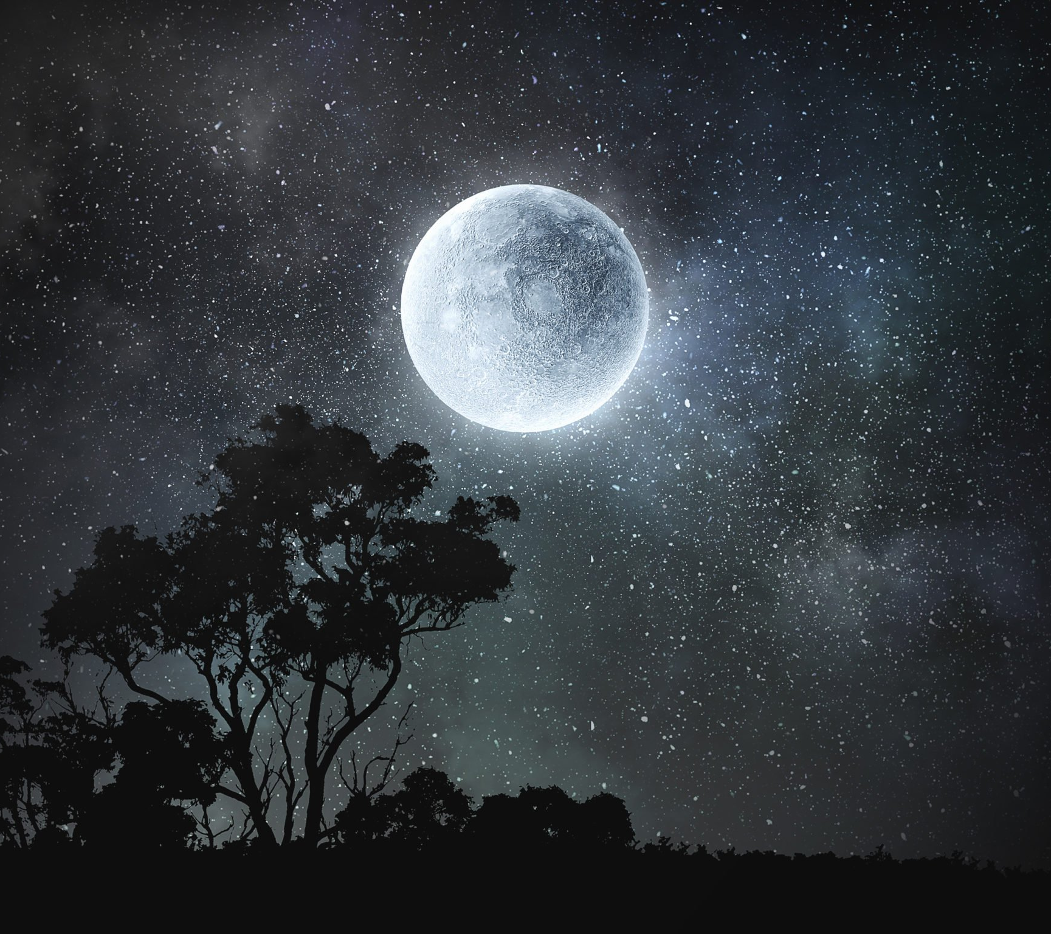
5. Full Moon – The entire face of the Moon is lit. The Full Moon occurs when the entire face of the Moon is lit by the Sun, as they are aligned on opposite sides of Earth
shutterstock_755632231-scaled.jpg (2560×1536)

Slide 11
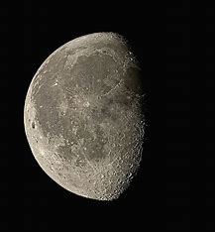
6. Waning Gibbous – The Moon starts shrinking. The Waning Gibbous phase is when the lit-up part of the Moon's face shrinks from about 100% to 50%. It starts just after Full Moon and lasts until the Third Quarter Moon
5-waning-gibbous-moon-eckhard-slawik.jpg (900×900)

Slide 12
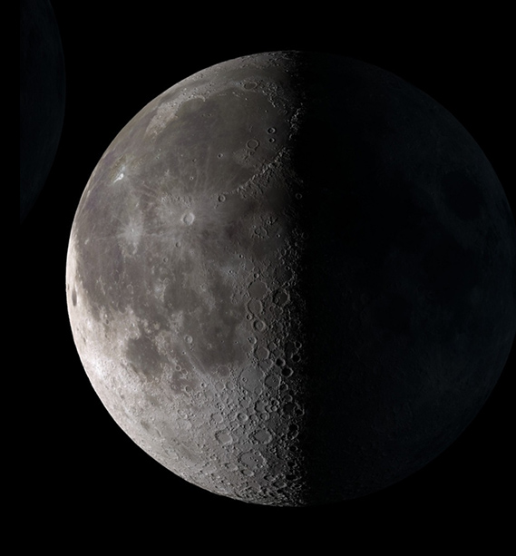
7. Last Quarter – Half of the Moon is visible again. During the Last Quarter Moon phase, half of the Moon's visible surface is illuminated, appearing as a crescent shape. It is also known as the Third Quarter Moon.
362 (640×613)

Slide 13
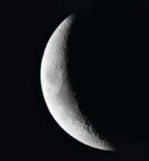
8. Waning Crescent – A small sliver of light remains. The waning crescent is a delicate sliver of light in the pre-dawn sky, marks the final stage of the moon’s monthly journey. This phase holds deep meaning and significance across cultures and sciences alike.
20-300x225.jpg (300×225)

Slide 14
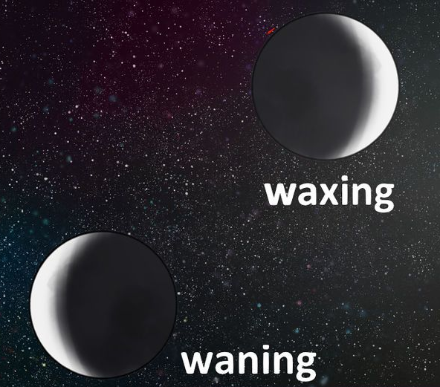
Waxing vs. Waning
aid815401-728px-Tell-Whether-the-Moon-Is-Waxing-or-Waning-Step-7-Version-2.jpg (728×546)
Waxing means the Moon is getting bigger (light on the right).
Waning means the Moon is getting smaller (light on the left).
A helpful trick: "Wax on, wane off!"

Slide 15
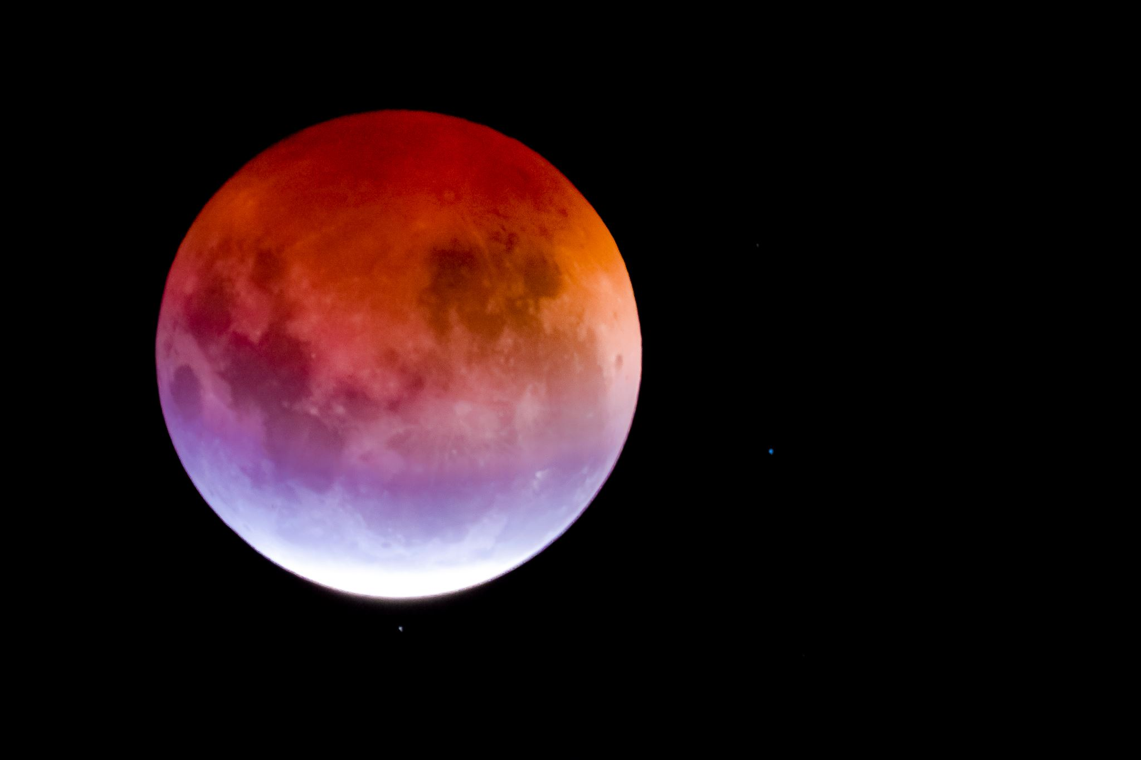
Vocabulary words:
Moon – Earth's natural satellite, a rocky object that orbits Earth and reflects sunlight.
Phases of the Moon – The different shapes of the Moon as seen from Earth, caused by the varying angles of sunlight.
New Moon – The phase when the Moon is not visible from Earth.
Waxing Crescent – The phase where a small sliver of light appears on the right side of the Moon.
First Quarter – The phase where half of the Moon is visible, with the right side lit.
Waxing Gibbous – The phase when most of the Moon is visible, with only a small portion of the left side dark.
Full Moon – The phase when the entire face of the Moon is lit and visible.
Waning Gibbous – The phase when the light on the Moon begins to shrink on the left side.

Slide 16
Vocabulary words:
Last Quarter – The phase when half of the Moon is visible again, with the left side lit.
Waning Crescent – The phase when only a small sliver of light remains on the left side.
Waxing – When the Moon is getting bigger, with light on the right side.
Waning – When the Moon is getting smaller, with light on the left side.
Orbit – The path the Moon takes around Earth.
Reflection – The bouncing of light off the Moon's surface, allowing us to see it from Earth.
Gravitational Pull – The force that the Moon exerts on Earth, causing tides.
Tides – The rise and fall of the Earth's oceans, caused by the Moon's gravitational pull.

Slide 17
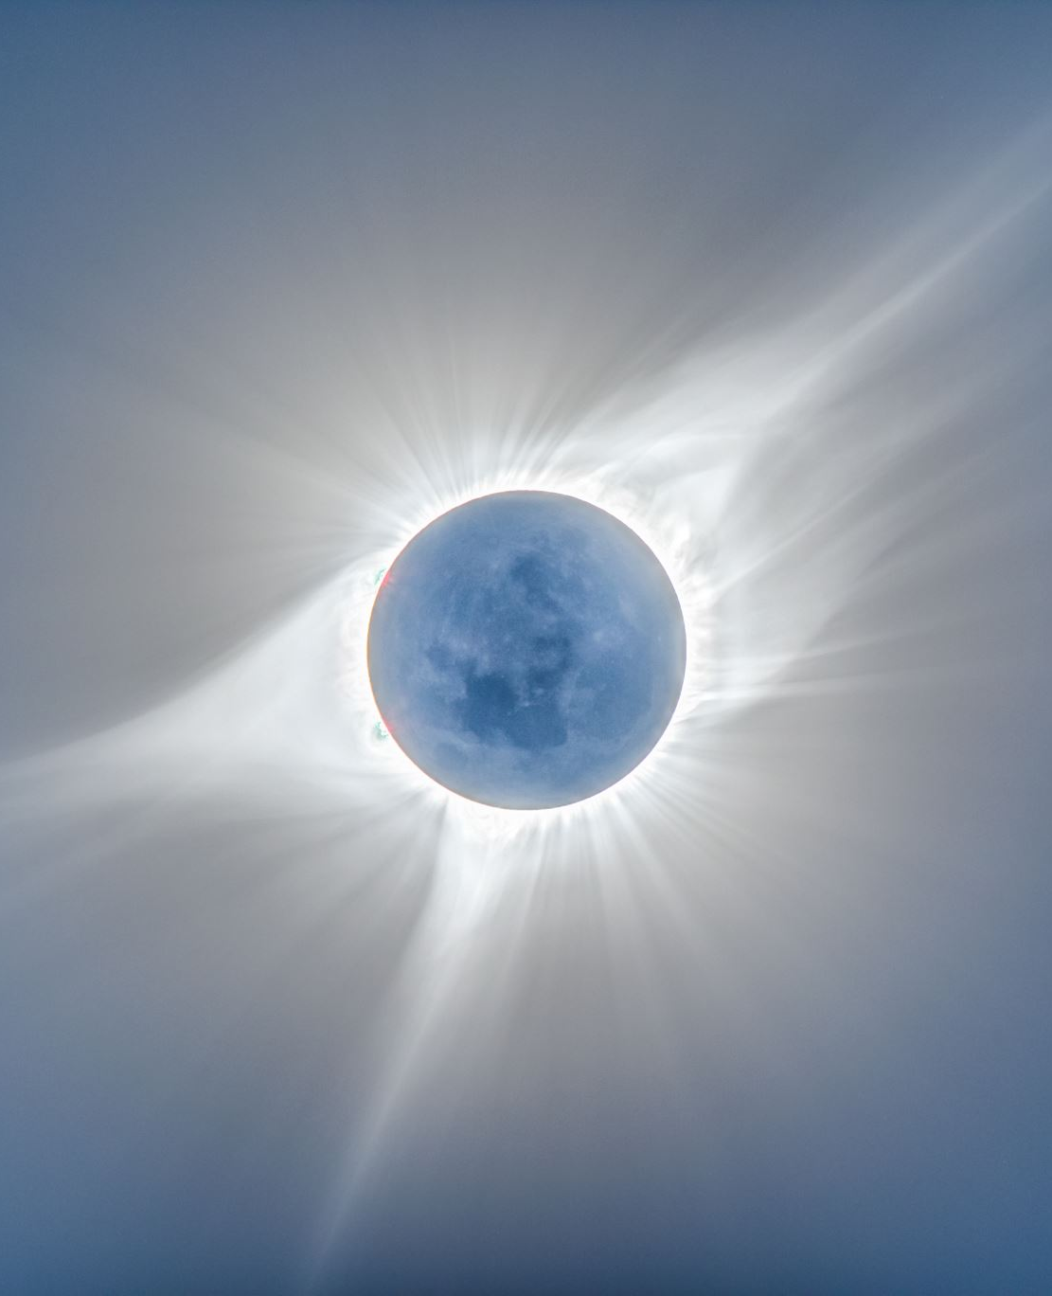
Related Concepts:
Eclipse – When the Moon passes in front of the Sun (solar eclipse) or when the Earth passes between the Sun and the Moon (lunar eclipse), casting shadows.
Sunlight – The light emitted by the Sun that reflects off the Moon to create the phases we observe from Earth.
Gravity – The force that attracts objects toward each other; the Moon’s gravity causes Earth’s tides and influences the Moon’s orbit.
Cycle – A sequence of events that repeats in the same order; the Moon’s phases form a cycle that lasts about 29.5 days.
Orbit – The path an object follows around another object in space, like the Moon’s orbit around Earth.
Satellite – A celestial body that orbits a planet; the Moon is Earth’s natural satellite.
Rotation – The spinning of an object on its axis; the Moon rotates on its axis as it orbits Earth, but it rotates at the same speed as it orbits, so we always see the same side of the Moon.
Tidal Locking – The phenomenon where the Moon’s rotation and orbit are synchronized, resulting in the same side of the Moon always facing Earth.
Lunar Cycle – Another term for the phases of the Moon, describing the complete sequence of the Moon's changes over the course of about 29.5 days.
Reflective Surface – A surface that bounces light; the Moon’s surface is reflective, allowing it to shine by reflecting the Sun’s light.

Slide 18
Let’s try this:
Question 1: What is the phase called when the entire Moon is visible? A. New Moon B. Full Moon C. First Quarter
Question 2: What does “waxing” mean? A. The Moon is getting bigger B. The Moon is getting smaller C. The Moon disappears
Question 3: How long does it take for the Moon to go through all its phases? A. 7 days B. 14 days C. 29.5 days

Slide 19
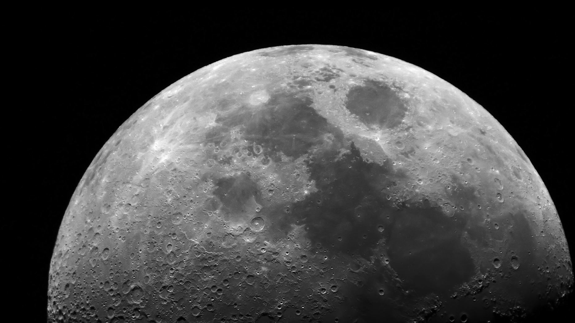
It’s time to make the project!
Phases of the moon

