Slide 1
Ecosystems and Food Webs
Understanding How Living Things Work Together
Florida Benchmark:
SC.4.L.17.2 – Explain that animals, including humans, cannot make their own food and that when animals eat plants or other animals, the energy stored in the food source is passed to them.
NGSS Standard:
4-LS1-1 – Construct an argument that plants and animals have internal and external structures that function to support survival, growth, behavior, and reproduction.
John Mark L. Barbado, M.Ed.
STEM Educator

Slide 2
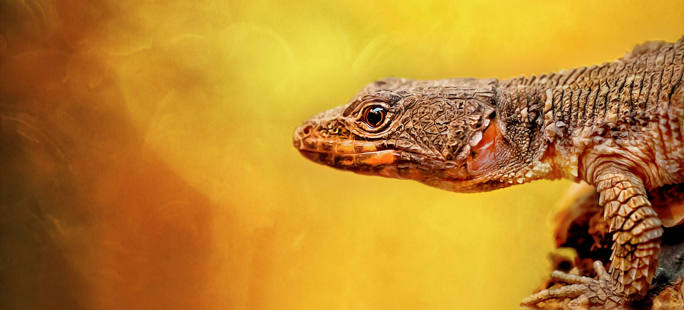
Essential Question
What would happen if a species went extinct?

Slide 3
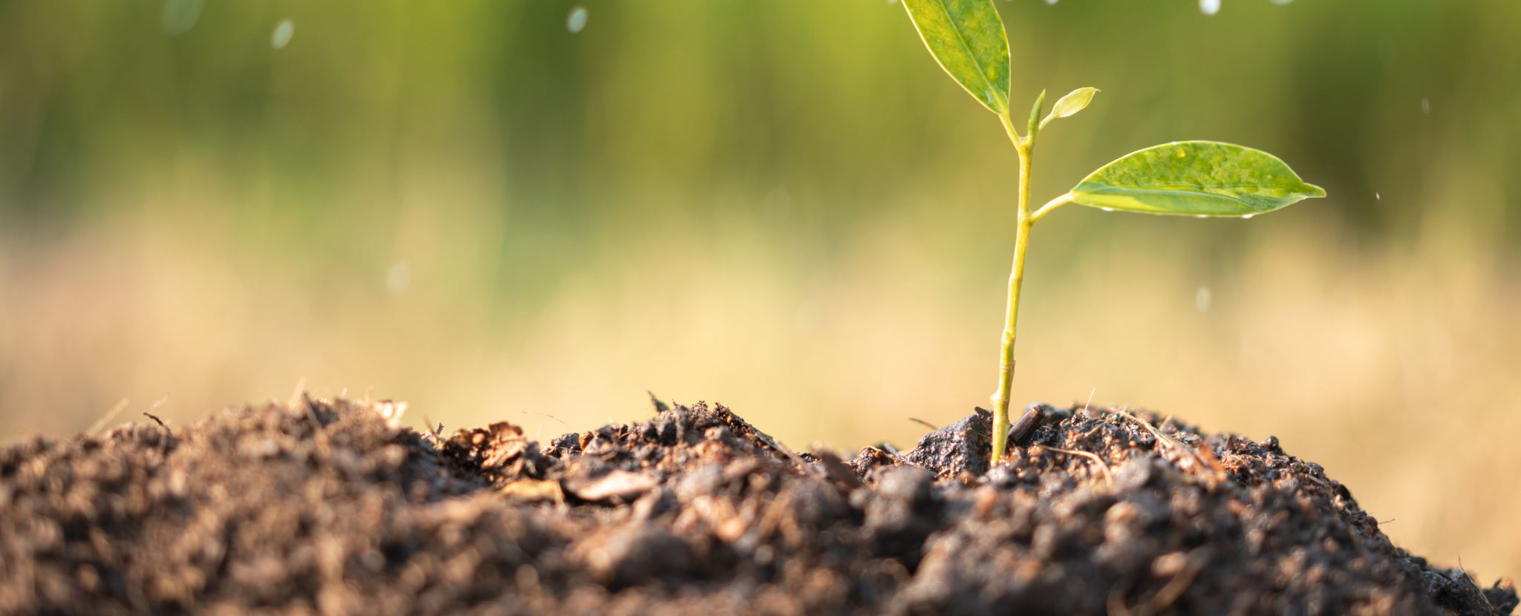
What is an Ecosystem?
An ecosystem is a system where living and non-living things work together. All parts of an ecosystem are connected.
- Living things: plants, animals, fungi
- Non-living things: sunlight, water, air, soil

Slide 4
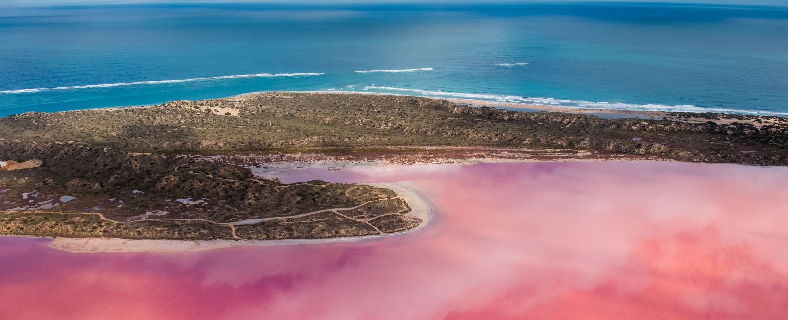
Examples of Ecosystems
Forests
Ponds
Oceans
Deserts
Your backyard

Slide 5
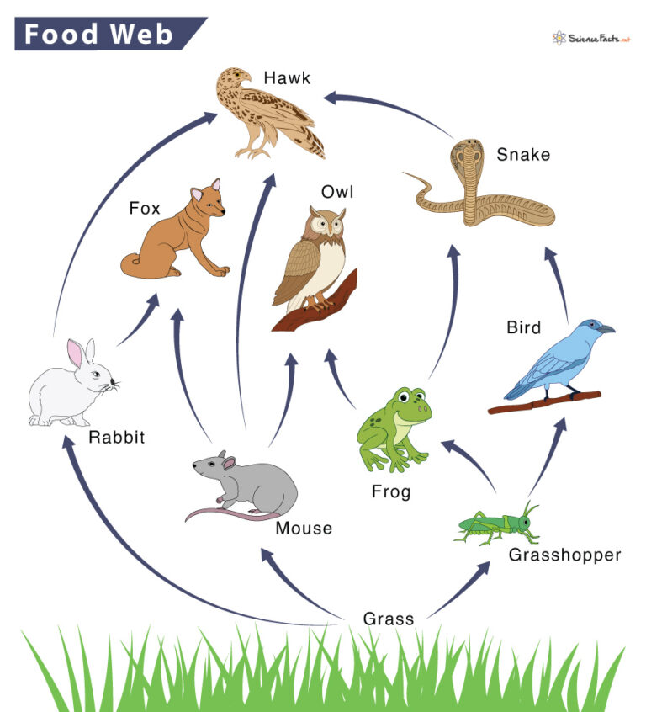
What is a Food Web?
A food web shows how energy moves in an ecosystem. It shows who eats what and connects many food chains together.
Food-Web-768x846.jpg (768×846)

Slide 6
Types of Organisms in a Food Web
1. Producers - Make their own food (e.g., plants)
2. Consumers - Eat other organisms (herbivores, carnivores, omnivores)
3. Decomposers - Break down dead things (e.g., fungi, bacteria)

Slide 7
Connection
Farmers grow crops (producers)
We eat food from plants and animals (consumers)
Composting helps the soil (decomposers)
We are all part of a food web!

Slide 8
Vocabulary Recap
Ecosystem – A place where living and non-living things interact
Producer – Makes own food
Consumer – Eats plants or animals
Decomposer – Breaks down dead things
Food Web – Shows energy flow in ecosystem

Slide 9
It’s time for the project making.
The Food Web Model

