Slide 1
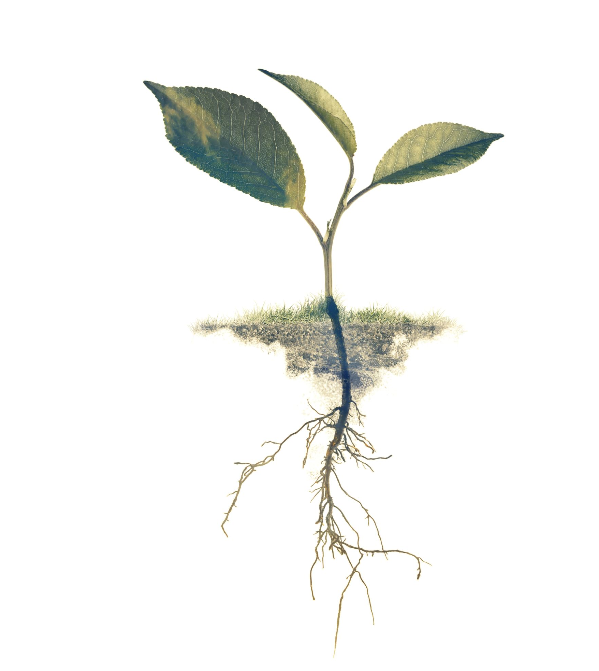
Structure of Roots and Leaves
Florida Benchmark: SC.3.L.14.1: Describe structures in plants and their roles in food production, support, water and nutrient transport, and reproduction.
NGS Standard: 4-LS1-1: Construct an argument that plants and animals have internal and external structures that function to support survival, growth, behavior, and reproduction.

Slide 2
Essential Questions:
How do the structures of roots and leaves support a plant's survival, growth, and reproduction?
Why are the roles of roots and leaves crucial for maintaining the balance of ecosystems?

Slide 3
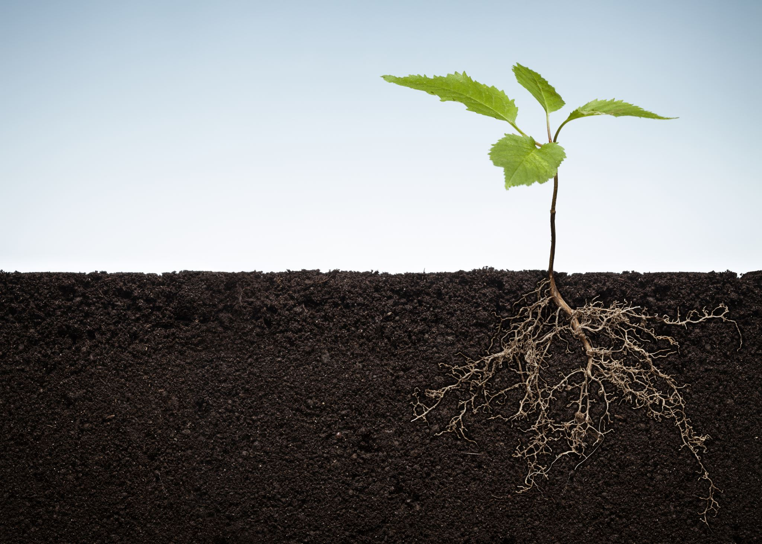
Why Are Roots and Leaves Important?
Roots anchor plants and absorb water and nutrients.
Leaves are essential for photosynthesis, producing food for the plant.

Slide 4
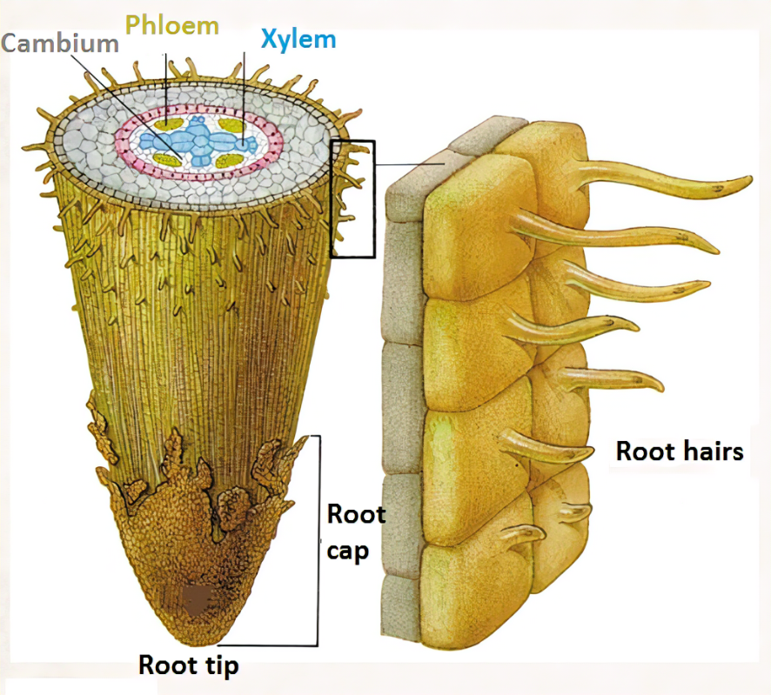
Key Parts of Roots
Root Cap: Protects the tip of the root.
Root Hairs: Absorb water and nutrients.
Xylem and Phloem: Transport water, nutrients, and food.
root+hair+cell+3.png (515×465)

Slide 5
Functions of Roots
Anchor plants in the soil.
Absorb water and nutrients.
Store food and nutrients.

Slide 6
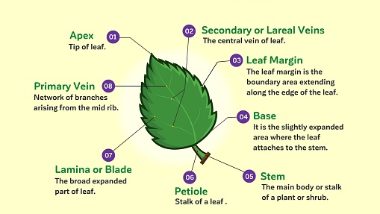
Structure of Leaf
structure-of-leaf.jpg (509×339)

Slide 7
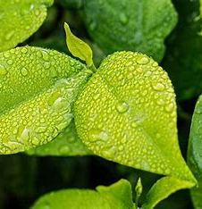
Functions of Leaves
What Do Leaves Do?
Perform photosynthesis to make food.
Help with transpiration (water loss).
Facilitate gas exchange (oxygen and carbon dioxide).
leaves - Search Images

Slide 8
How Are Roots and Leaves Different?
Roots: underground, absorb water and nutrients, no photosynthesis.
Leaves: above ground, perform photosynthesis, gas exchange.

Slide 9
Generalization
Roots and leaves are vital for plant survival.
Roots support, absorb, and store.
Leaves produce food and exchange gases.

Slide 10
Related Concept:
Photosynthesis – The process by which leaves convert sunlight into energy for the plant.
Absorption – How roots take in water and nutrients from the soil.
Transpiration – The release of water vapor from leaves into the air.
Xylem and Phloem – The transport systems in plants that move water, nutrients, and food.
Anchorage – The role of roots in keeping plants stable in the ground.

Slide 11
The Root and the Leaf
Parts of a Plant and Their Functions for Kids | Root, Stem, Leaf, Flower & Fruit
Root Functions
Parts of a Plant: Roots
(37) Parts of a Plant: Roots – YouTube
PARTS OF A LEAF | Leaf Parts and their Functions | Science Lesson

Slide 12
Experiment Time!

