Slide 1
Understanding the Water Cycle: A Key to Life on Earth
An overview of the key stages in the water cycle
Florida Benchmark: SC.5.E.7.1: Create a model to explain the parts of the water cycle.
NGSS Standard: 5-ESS2-1: Develop a model using an example to describe ways the geosphere, biosphere, hydrosphere, and atmosphere interact.
John Mark L. Barbado, M.Ed.
STEM Educator

Slide 2
Essential Question
How does the water cycle support life on Earth and shape our environment?
Notes:
The water cycle supports life on Earth by constantly recycling and distributing water across the planet. This process ensures that living things—plants, animals, and humans—have access to the water they need for survival. For example, precipitation provides fresh water for drinking and irrigation, while evaporation and transpiration help regulate temperature and climate. The cycle also shapes our environment by influencing weather patterns, forming rivers and lakes, and supporting ecosystems. Without the water cycle, Earth would be dry, lifeless, and unable to support the diversity of organisms that depend on water every day.

Slide 3
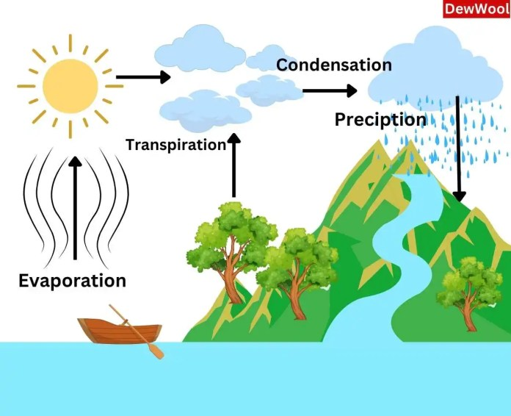
The Water Cycle
The water cycle is a natural process that describes how water moves around our planet. It’s essential to life because it helps distribute water across the Earth, ensuring that plants, animals, and humans have the water they need to survive. This cycle involves several key stages: evaporation, condensation, precipitation, collection, transpiration, and runoff.
Water_cycle_diagram.webp (696×566)

Slide 4
Key Stages of the Water Cycle
1. Evaporation: Sun heats up water, turning it into vapor.
2. Condensation: Water vapor cools down and forms clouds.
3. Precipitation: Water falls as rain, snow, etc.
4. Collection: Water gathers in bodies like rivers and lakes.
5. Transpiration: Plants release water vapor into the air.
6. Runoff: Water flows over land and returns to oceans/lakes.

Slide 5
Why the Water Cycle is Important
The water cycle distributes and recycles water, supporting life on Earth. It ensures that water is available for drinking, farming, and other needs.

Slide 6
Real-World Applications of the Water Cycle
Weather forecasting: Predicting rainfall, storms.
Agriculture: Farmers rely on precipitation for crops.
Urban planning: Managing runoff and water supplies.

Slide 7
Think-Pair-Share
Think About It! How would life be different if one stage of the water cycle didn’t happen?
Remember: ✔️ Think for 1 minute ✔️ Pair with a classmate ✔️ Share your ideas with the class

Slide 8
Learning Goal Reflection
Name two stages of the water cycle and explain what happens in each.
Why is the water cycle important to people, plants, and animals?

Slide 9
References
National Aeronautics and Space Administration (NASA). (n.d.). The Water Cycle. Retrieved from https://www.nasa.gov
U.S. Geological Survey (USGS). (n.d.). Water Cycle Basics. Retrieved from https://www.usgs.gov

Slide 10
It’s time to make the project!
The Water Cycle Model

