Slide 1
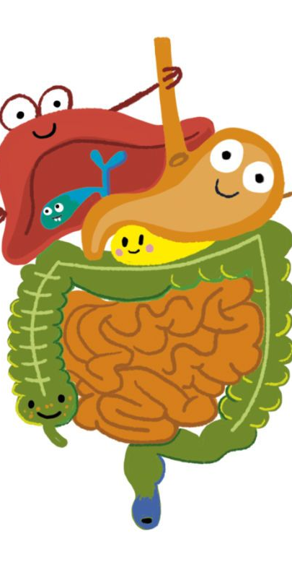
The Digestive System: How Our Body Processes Food
digestive-system-clipart-1.jpg (700×796)
Florida Benchmark SC.5.L.14.2: Explain the function of the digestive system in breaking down food and absorbing nutrients.
NGSS Standard MS-LS1-7: Develop a model to describe how food is rearranged through chemical reactions forming new molecules that support growth and/or release energy as it moves through an organism.
JOHN MARK L. BARBADO, M.Ed.
STEM Educator

Slide 2
Lesson Objectives
- Identify the major organs of the digestive system
01
- Explain how food is broken down and how nutrients are absorbed
02
- Demonstrate understanding through hands-on activities
03

Slide 3
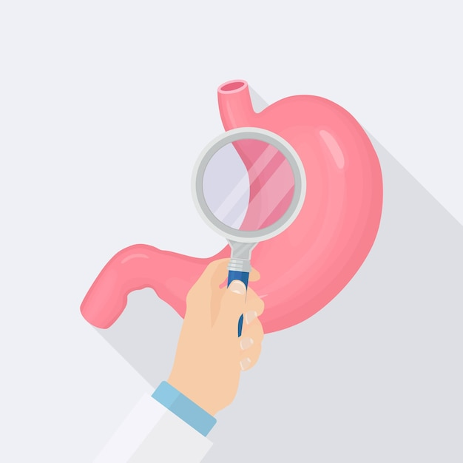
Essential Question
How does the digestive system break down food and absorb nutrients to help our body function?
doctors-checkup-stomach-man-examine-organ-by-magnifying-glass-make-diagnosis_284092-2246.jpg (626×626)

Slide 4
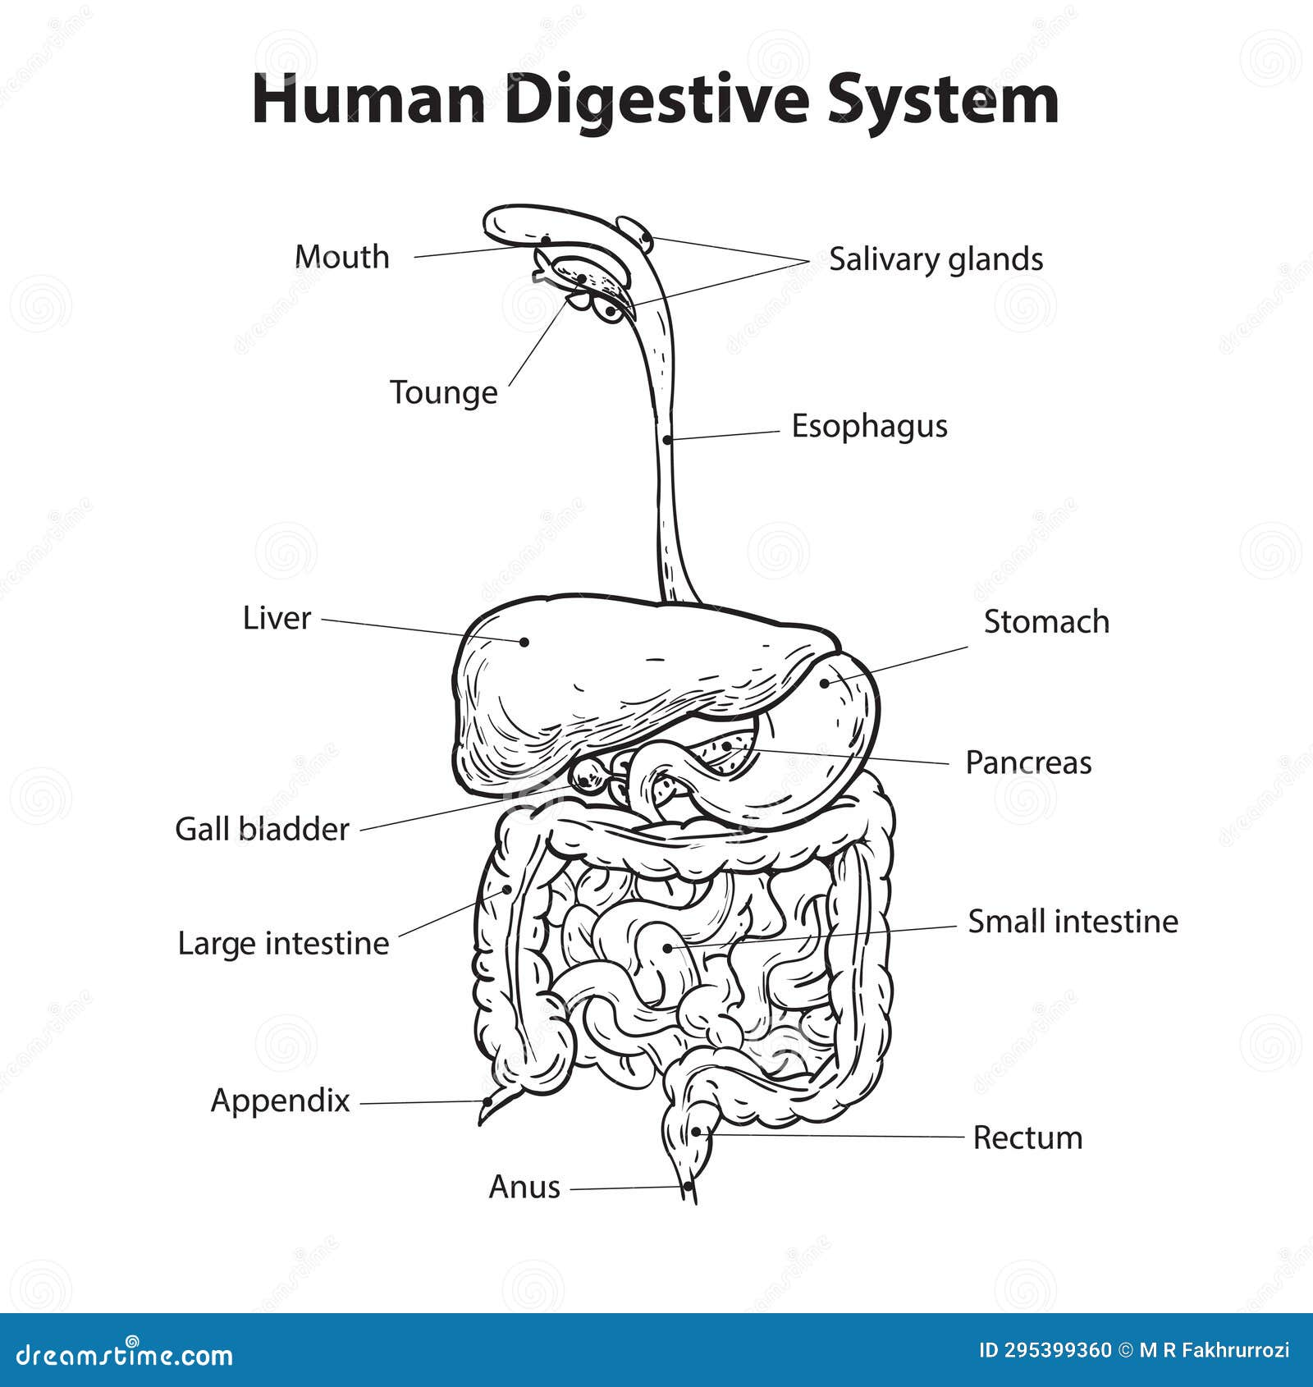
The DIGESTIVE SYSTEM helps break down food so the body can use it for energy and growth. In the small intestine, nutrients from food mix with the blood and travel to different parts of the body. These nutrients help you stay strong, grow, and stay healthy. Whatever the body doesn’t need is removed as waste. The digestive system is important because it gives your body the fuel it needs to work properly!
human-digestive-system-diagram-vector-illustration-simple-black-white-outline-health-medical-human-digestive-system-295399360.jpg (1600×1690)

Slide 5
The Digestive System: Organs and Functions
Mouth – Chews food, starts digestion with saliva
2. Esophagus – Moves food to stomach
3. Stomach – Breaks food down with acid and enzymes
4. Small Intestine – Absorbs nutrients
5. Large Intestine – Absorbs water, removes waste

Slide 6
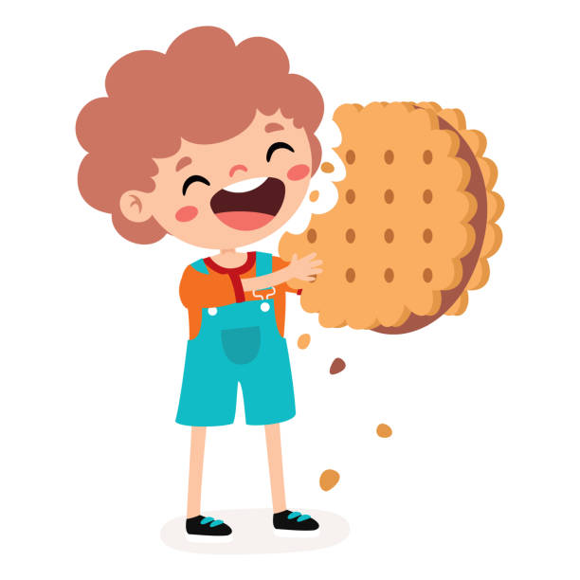
Chew on This!
Get a cracker.
Chew for 30 seconds without swallowing.
How does the taste change? Why?
Saliva starts breaking food down into simpler sugars!
illustration-of-kid-with-biscuit.jpg (612×612)

Slide 7
How Digestion Provides Energy?
Food is broken down into molecules.
These molecules provide energy for movement, growth, and thinking.
People such as athletes need food to perform well.
Without digestion, we would have no energy!

Slide 8
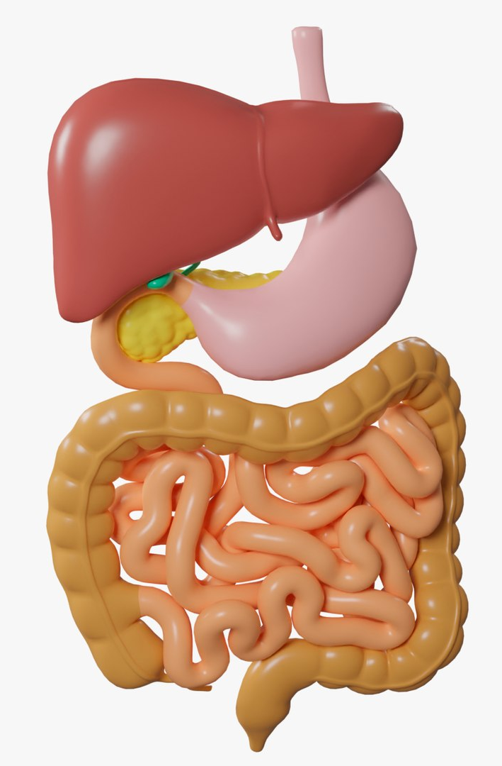
Digestive System | The Dr. Binocs Show | Learn Videos For Kids

Slide 9
Where does digestion begin?
Digestion starts in your mouth! When you chew, your teeth break the food into smaller pieces, and your saliva (spit) helps make it soft. Your spit also has special helpers called enzymes that start breaking down the food, especially things like bread and rice. This makes it easier for your stomach to do the next step of digestion!

Slide 10
What does the stomach use to break down food?
Your stomach helps break down food using stomach acid and special helpers called enzymes. The acid helps make the food soft and kills germs, while the enzymes help break big food pieces into smaller ones. Your stomach also squeezes and mixes everything into a smooth, soupy liquid so your body can use the nutrients!

Slide 11
What happens in the small intestine?
In the small intestine, food gets fully broken down and the good stuff (nutrients) is taken into the body. Special juices from the pancreas and liver help break food into tiny pieces. The walls of the small intestine soak up the nutrients and send them into the blood. The blood carries the nutrients all over the body to give you energy and help you grow! Whatever is left moves to the large intestine to get rid of waste.

Slide 12
Why is digestion important?
Digestion is important because it helps your body get the nutrients it needs to grow, stay strong, and have energy!
- It breaks down food into tiny pieces so your body can use it.
- Nutrients from food go into your blood and travel to all parts of your body.
It helps you stay healthy by giving your body what it needs to work properly.
- Digestion also gets rid of waste that your body doesn’t need.
Without digestion, your body wouldn’t get the energy and nutrients needed to grow, think, and play!

Slide 13
Explore: Digestion in Action
• Place a cracker in a plastic bag (stomach)
• Add water + vinegar (stomach acid)
• Mash gently to show digestion
• Use a sponge to absorb nutrients (small intestine)

Slide 14
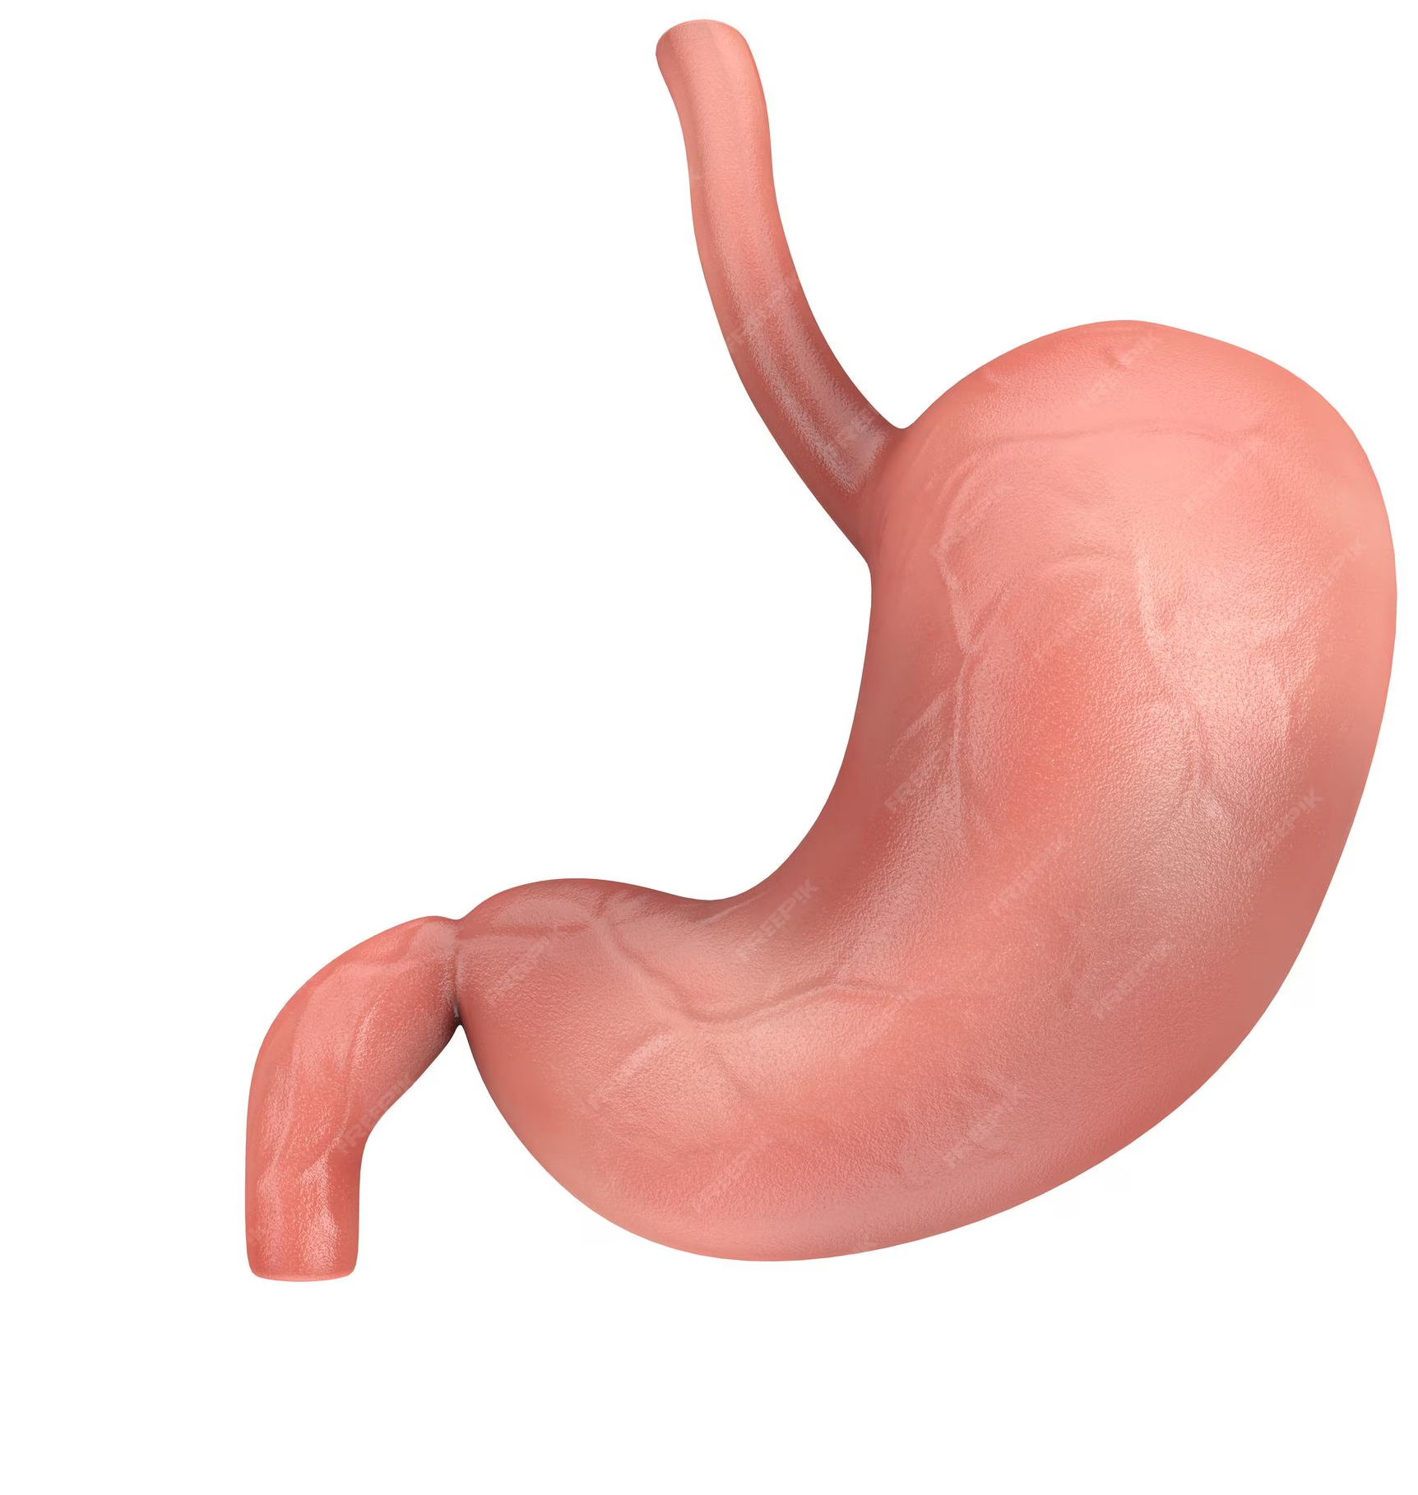
It’s time to do the experiment!
Digestion in Action!

